Slide 1

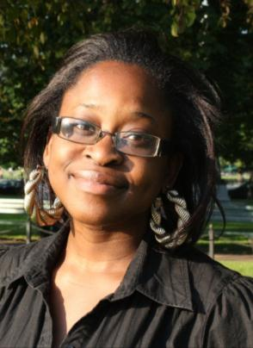









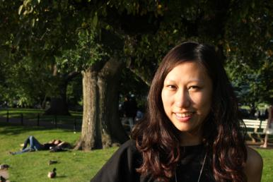

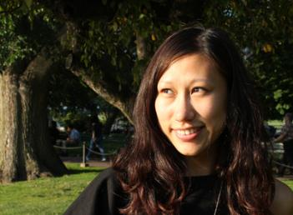


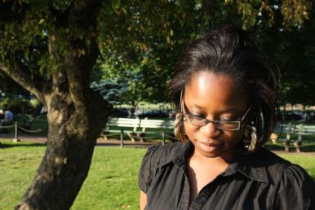
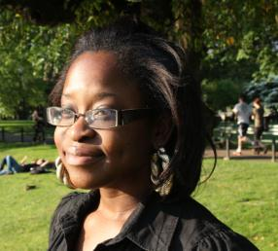
meet your GimmeGimme marketing team
  Derrain Anthony – Account Manager “The Maverick”
  Cathy Chao – Creative “The Visionary”
  Hao Quan – Media Planner “The Dreamer”
  Mimi Staveley – Public Relations “The Enforcer”
The exclusive online boutique that offers
previously loved high-end designer merchandise
at a fraction of the cost!
1

Slide 2

agenda
  About GimmeGimme
  Situational Analysis
      Customers, Market & Competitors
  GimmeGimme’s SWOT
  Target Audience Profile of Consignment Shoppers
  Who are GimmeGimme customers?
  Who are GimmeGimme consigners?
  Our Marketing/Communications objectives
  GimmeGimme communication strategies
      Creative Brief, Media/Internet Strategy & PR/Promotions plan
  Campaign Budget
  Recommendations
  Q&A
2

Slide 3
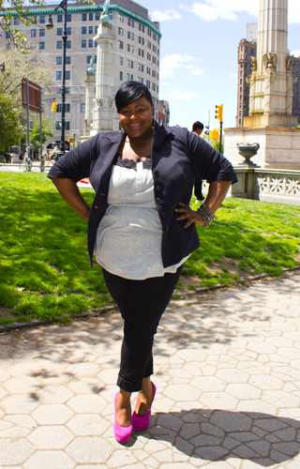
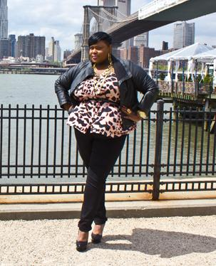
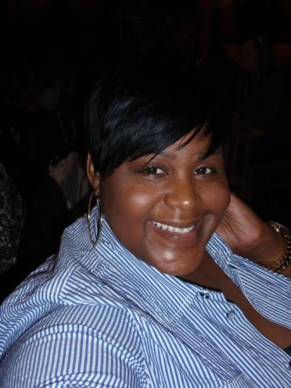
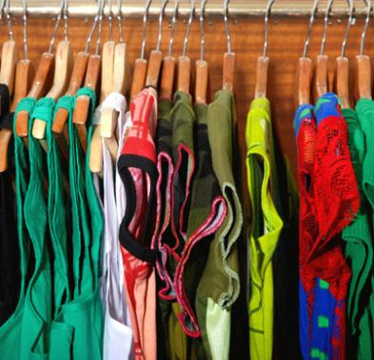

about GimmeGimme
  start-up business that seeks to generate awareness and increase sustainability
  online consignment boutique that sells quality luxury items at a reduced cost
  founded by Tiffany Fuller – marketing professional and graduate of Emerson College
  Tiffany got the inspiration for GimmeGimme from items collected in her closet
  current database of 130-140 customers, of which 30-40 are consigners, based in New York
  GimmeGimme customers are mostly female luxury goods lovers, ages 25 to 60
3

Slide 4

situational analysis: customers
  Females 18+ believe that designer labels and exclusivity are key differentiations of luxury
  Every racial group cares about different factors of luxury goods
  Many consumers reported that they buy luxury goods if they are drastically reduced in price
  Online retailers are encouraging consumers to buy luxury at a discounted price
  Higher income, higher educated customers without children are a desirable demographic for online retailers
4

Slide 5

plain tops
jeans
heels
situational analysis: market
  Ongoing economic downturn caused consumers to re-shift their purchasing habits to maximize savings
  Consignment stores and resale shops have seen expanded growth due to their cost savings appeal
  Amazon, eBay, and Craigslist have created opportunities for buyers/sellers of consignment goods without going to a store location
  2008 survey by Nielsen Global Online confirms clothing, shoes, and accessories are increasingly purchased by Internet consumers
leggings
earrings
Cosmetics
stylish tops
Hair
Products
5

Slide 6
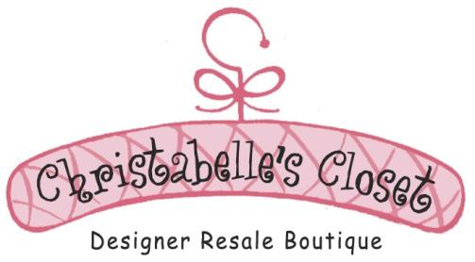



situational analysis: competitors
  GimmeGimme main competitors are:
      Primary: online consignment retailers
      Secondary: physical consignment retailers
      Tertiary: counterfeit designers items
  Christabelle’s Closet and CovetShop are two popular online consignment retailers in NYC
  Michael Consignment and Second Time Around are two examples of physical consignment retailers in NYC
  Counterfeit designer items are sold on the street due to their illegality
6

Slide 7
GimmeGimme’s SWOT
Strengths
Weaknesses
Luxury goods at a discounted price
Excellent customer service
A one-stop shop for buyers and cosigners
Limited brand awareness among consumers
Lack of presence and marketing promotions within marketplace – particularly Brooklyn, NY
Ineffective positioning and placement within the market
Lack of interactive presence via Social Media platforms
Restricted financial resources
Ineffective method of verifying authenticity of goods
Company website lacks flash capability
Website needs to be compatible with mobile devices
Opportunities
Threats
Post recession: a new interest in price-point shopping
Fast growth of e-commerce and online sales business
Market developments in a growing industry
Online consignment retailers
Physical consignment retail locations
Brand retail locations
Counterfeit luxury item retailers
7

Slide 8
concerns of
experienced shoppers
concerns of
inexperienced shoppers
Customer Service 2%
8

Slide 9
target audience profile of consignment shoppers
  We collected demographic data about purchasers of consignment goods through online/offline consignment retailers:
    64.2% of consignment shoppers are female
    67.7% are between the ages of 18 and 49
    66.1% of consignment shoppers do not have children
    44.1% of consignment shoppers had college degrees
    45.7% had an annual income of $60,000 or more
9

Slide 10

who are GimmeGimme customers?
  Women between the ages of 25 and 45 (with a 5-year margin either way)
  Live in New York City (particularly Brooklyn)
  Household Income between $50,000 and $100,000 annually
  Love high-end designer labels that are sold independently or at luxury retail stores (such as Neiman Marcus, Saks Fifth Avenue and Bergdorf Goodman, etc)
  Love collecting special edition and seasonal designer items
  “Treasure hunters”, looking for the best deal on the labels they love
who are GimmeGimme cosigners?
  Women between the ages of 25 and 45 (with a 5-year margin either way)
  Live in New York City (particularly Brooklyn)
  Household Income between $50,000 and $100,000 annually
  Love high-end designer labels that are sold independently or at luxury retail stores (such as Neiman Marcus, Saks Fifth Avenue and Bergdorf Goodman, etc)
  Love the ownership aspect of acquiring designer labels (which is the reason they need to sell their items, more closet space!)
  “Treasure Keepers”, looking for ways to capitalize on their current merchandise in order to acquire more recent merchandise
10

Slide 11



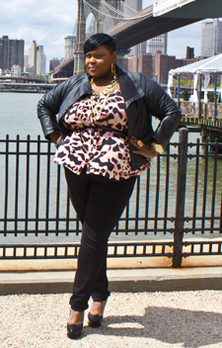







11

Slide 12

GimmeGimme communication strategies
  GimmeGimme has three main marketing and
  communications objectives to achieve within the next six months:
      Establish brand awareness in the Brooklyn area
      Enhance loyal connections with consigners and increase consigner database by 60%
      Increase customer database by 50%
  How do you define GimmeGimme, Consignment, and
  LuxFashion?
      Consignment – process of exchanging goods/products between the consignor/consignee for a return of investment on both parties
      GimmeGimme – a treasure hunter that is consistently on the search for high end luxury gems that is sold at an affordable price from Me to You
      LuxFashion – is the art of taking high-end luxury
      items and accessories to create your own unique
      individual style – it is what “fashionistas” crave –
      Desire from Me to You
12

Slide 13

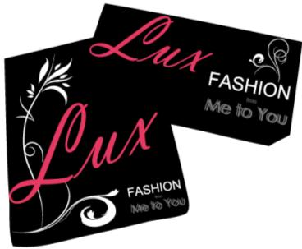


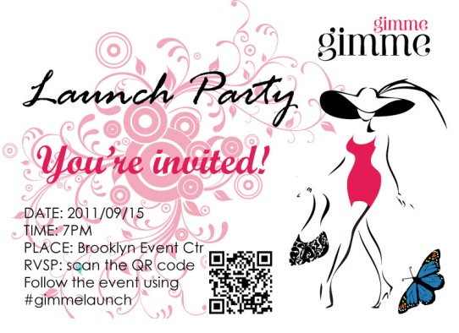

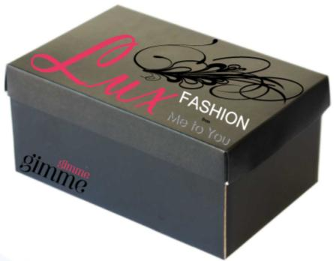



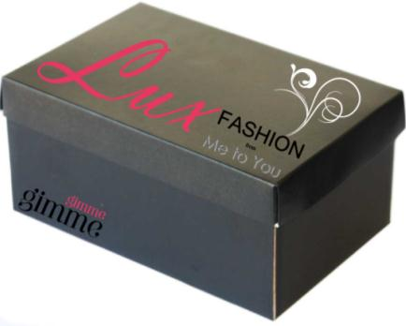
creative brief: packaging, customer service
Print on high-quality material
Build on current marketing and brand efforts
creative brief: brand materials
Perceptions/ Tones/ Guidelines
Reputation + Consistency
Black + Pink and same typography
13

Slide 14
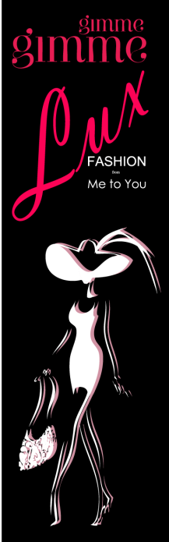






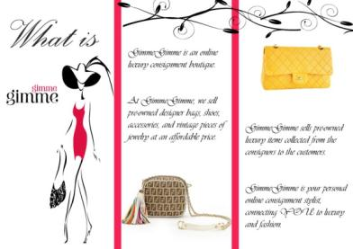
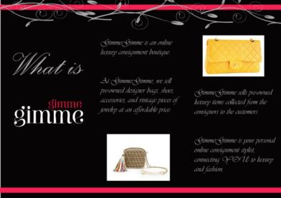
creative brief: event materials
Easy to find information and navigate
creative brief: business cards, brochures
Stylish, high-end, trendy
Fresh, conversational and friendly tone
14

Slide 15
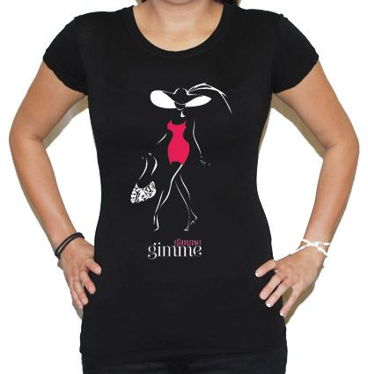
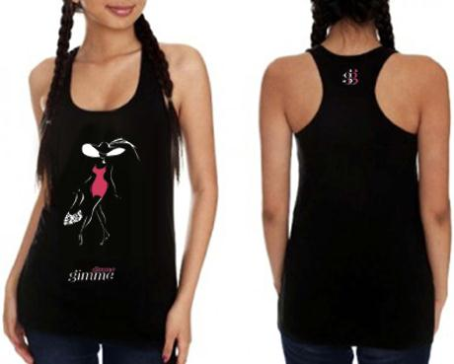
creative brief: giveaways or employee
From Me to You
Build on Brand Efforts
15

Slide 16

media strategy
  Goal: To utilize social media to build brand awareness and to generate online buzz
16

Slide 17
media strategy
  Facebook: “Like Me” Ad Campaign
  Twitter: Be “Proactive” – not only “Reactive”
  Forums: Media buying & Thread Creating similar to “PurseForum”
  Blog: Link building to
  spread the word about
  GimmeGimme
17

Slide 18
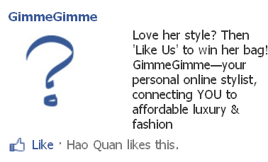
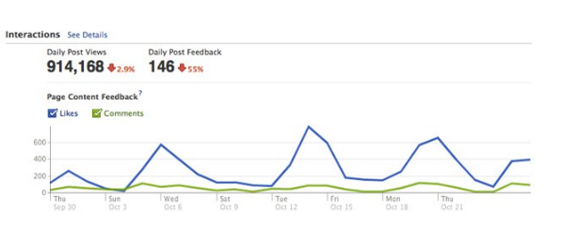
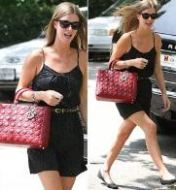
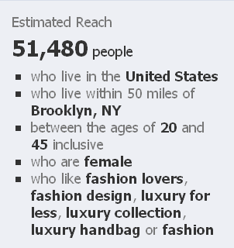
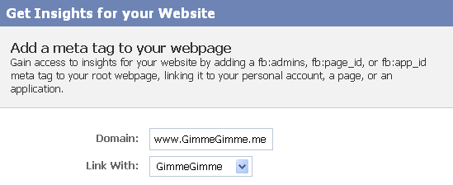
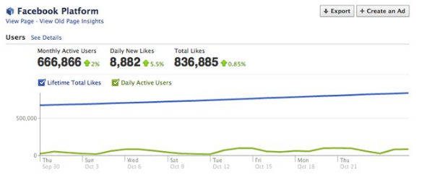
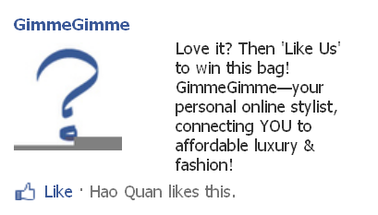
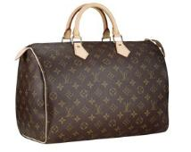
Facebook: “Like Me” Ad Campaign
18

Slide 19

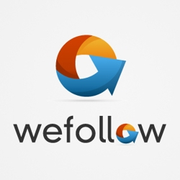

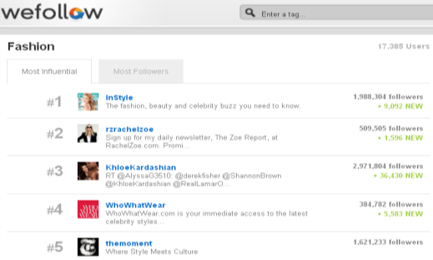
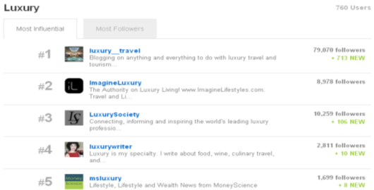

Twitter: be “proactive” – not only “reactive”
19

Slide 20
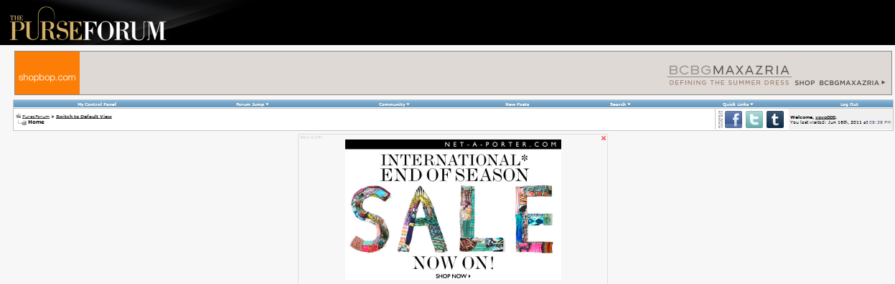
media buying and thread count creating similar to “PurseForum”
20

Slide 21



blog: link building to spread word about GimmeGimme
21

Slide 22

Internet strategy
  SEO: Onsite and Offsite Optimization Strategy
  Paid Search: Google Ads Campaign
  Email Marketing: Personal and customized to build loyal connections
Internet strategy
  Goal: We are going to use SEO and Paid Search to drive traffic and increase page ranking
22

Slide 23
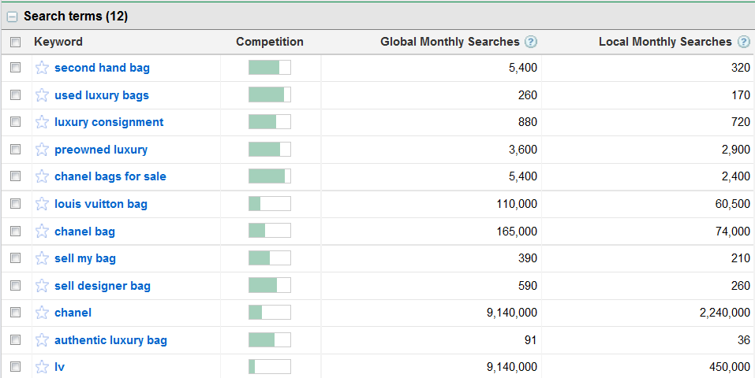
SEO+PPC
23

Slide 24
GimmeGimme media plan
“Facebook Insights” Tracking
Facebook “Like Me” Campaign
Media Buying: PurseForum
Blog Link Building Report
timeline
September 2011
October 2011
November 2011
December 2011
January 2011
February 2011
SEO+PPC Search Campaign
Twitter, Blog Influencers Pitches and Follow-ups
Email Marketing Report
24

Slide 25
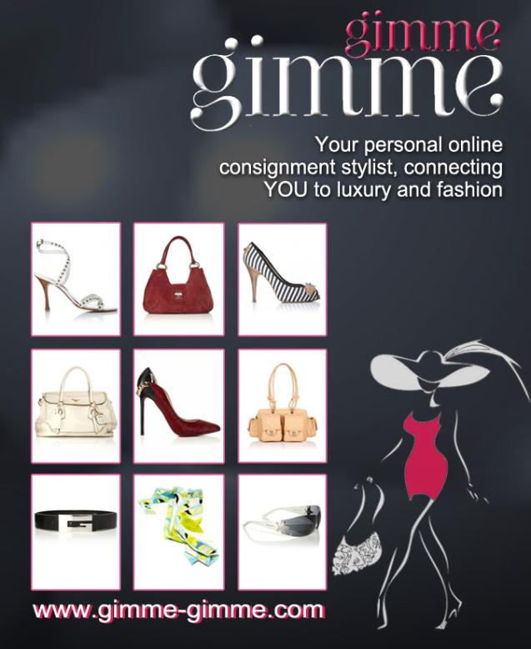
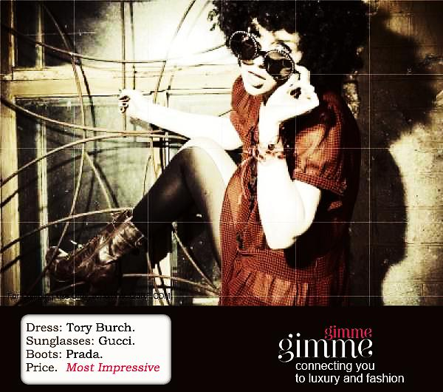
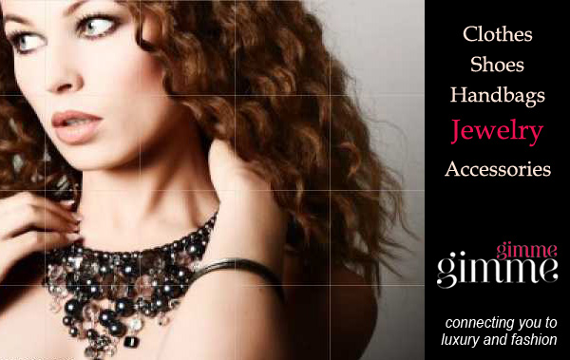
public relations
Me-to-You Tour Campaign
Customers
Cosigners
GimmeGimme Street Team
Associations
Online Connections
Website launch and
fashion show
25

Slide 26


promotions
Price Promotions for Holidays, Events & FW
Random Giveaways
    Facebook Fan Page Likes
    GimmeGimme Fan Photos
26

Slide 27
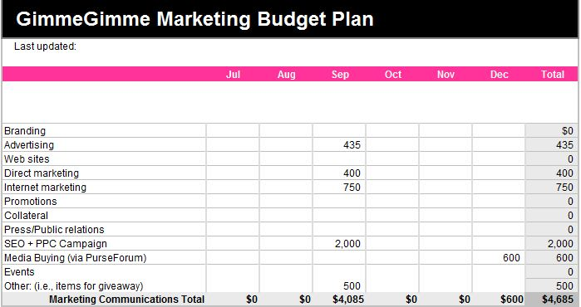
campaign budget
27

Slide 28
recommendations
  Connect with NYS – Small Business Development Center which helps position clients for success with their small businesses – FREE of charge
      Discover source of funding
      Prepare for eCommerce
      Comply with licensing and regulations
      Develop marketing plans
      Assess an inventions liability
  Become a member of American Business Women Association - great resource and networking tool for professional women
  Sell current inventory through “justsellitstore.com” – until website is up and functional as this site specializes in “selling high-end luxury” items
  Postpone release of Website until September 2011
28

Slide 29
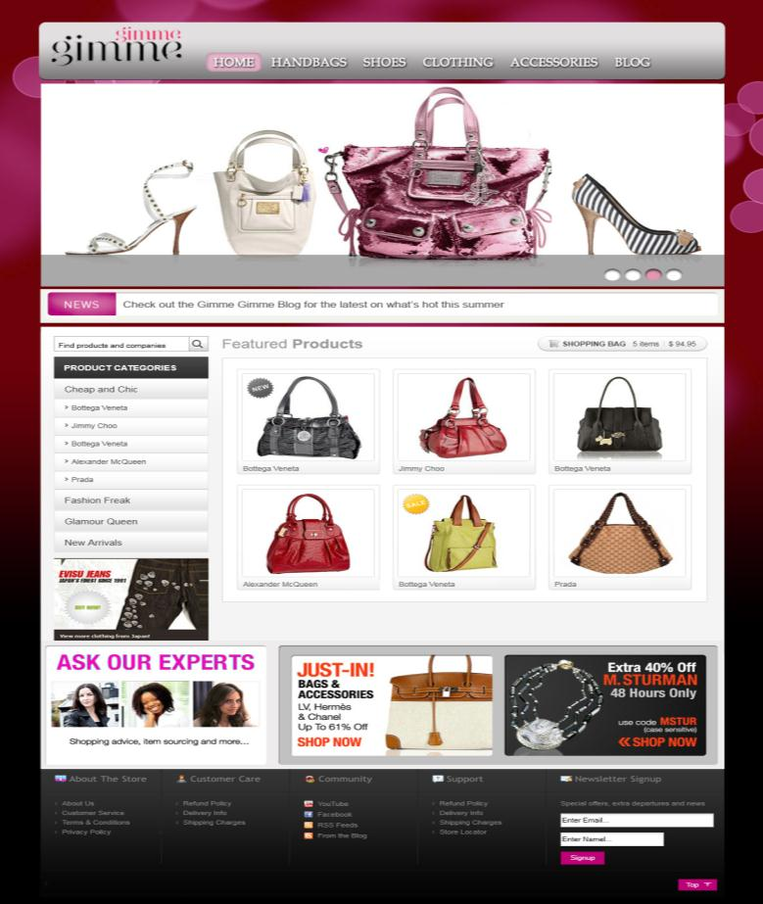
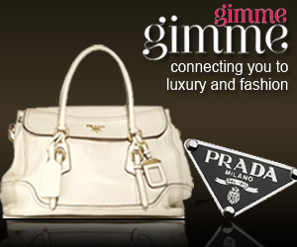

www.gimme-gimme.com
29

Slide 30



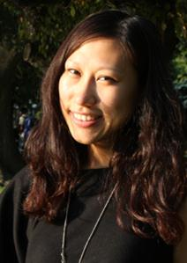

final thoughts
Passion
People
Personal
30

Slide 31
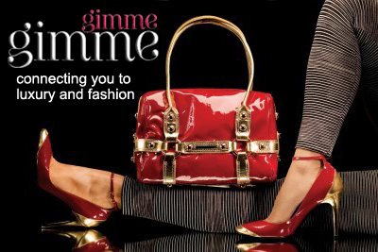
Q&A
31

