Slide 1
UPSIDE DOWN DIVERSITY
DIVERSITY
Andrés T. Tapia, Senior Partner, Korn/Ferry International
Follow the diversity trends & insights blog: inclusionparadox.com
TEDx Indianapolis

Slide 2

We LIVE in an
UPSIDE DOWN WORLD…
Notes:
We live in an Upside Down World:
The US' position in geopolitics
The way healthcare will work in the US
How products get manufactured
How we consume entertainment
How we connect with one another

Slide 3
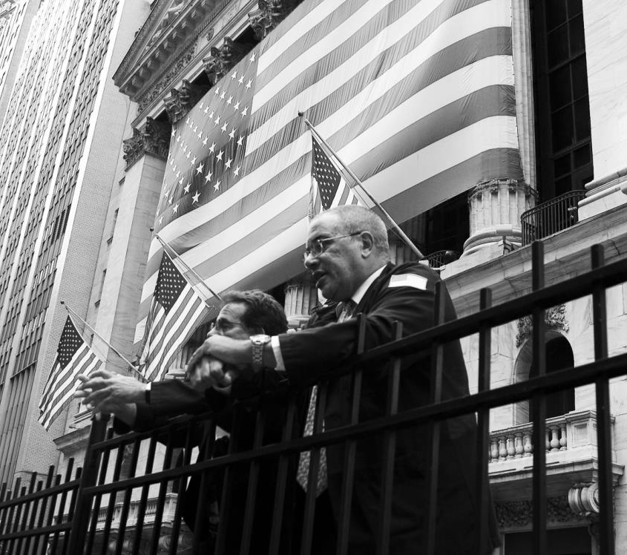
UPSIDE DOWN
Financial Systems
Notes:
We live in an Upside Down World:
The US' position in geopolitics
The way healthcare will work in the US
How products get manufactured
How we consume entertainment
How we connect with one another

Slide 4
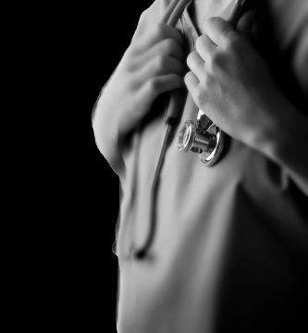
UPSIDE DOWN
Healthcare
Notes:
We live in an Upside Down World:
The US' position in geopolitics
The way healthcare will work in the US
How products get manufactured
How we consume entertainment
How we connect with one another

Slide 5
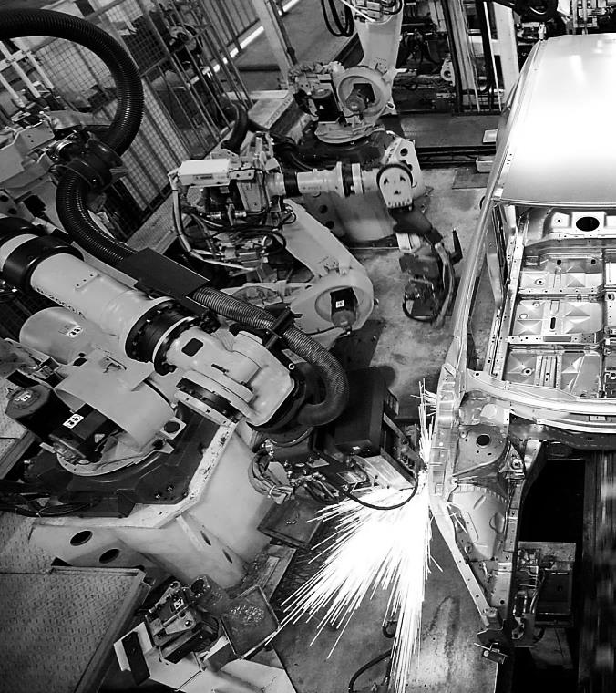
UPSIDE DOWN
Manufacturing
Notes:
We live in an Upside Down World:
The US' position in geopolitics
The way healthcare will work in the US
How products get manufactured
How we consume entertainment
How we connect with one another

Slide 6
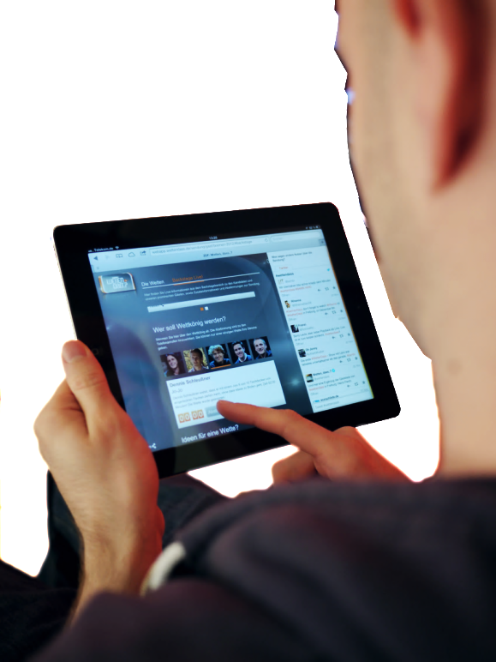
UPSIDE DOWN
Connectivity with Others
Notes:
We live in an Upside Down World:
The US' position in geopolitics
The way healthcare will work in the US
How products get manufactured
How we consume entertainment
How we connect with one another

Slide 7
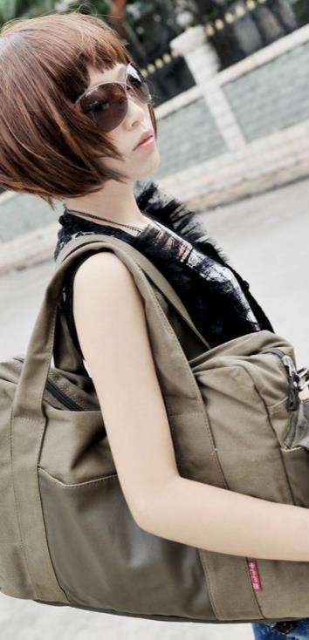
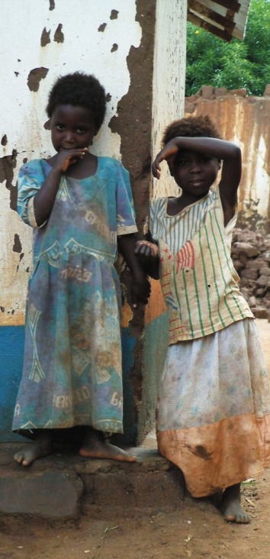
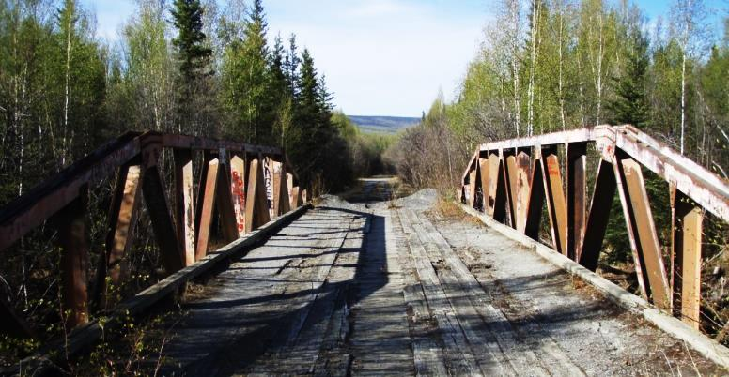
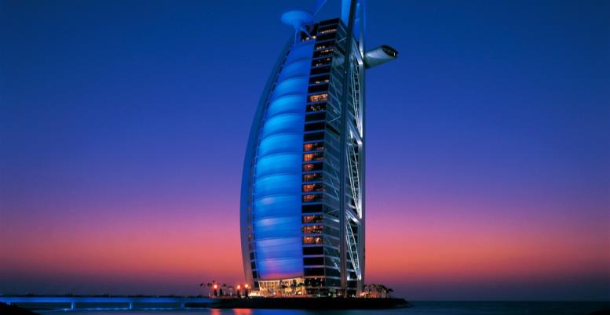
UPSIDE DOWN
Economic Superpowers
Notes:
We live in an Upside Down World:
The US' position in geopolitics
The way healthcare will work in the US
How products get manufactured
How we consume entertainment
How we connect with one another

Slide 8
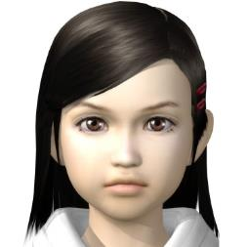
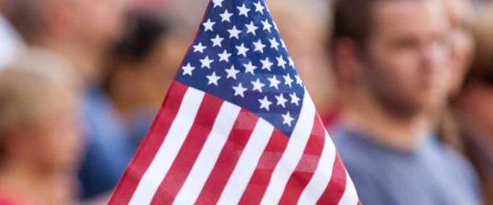

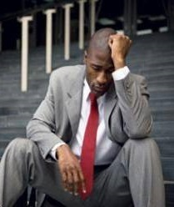


So in a Post…
How do we prepare our ourselves?
Post…
Modern
Post…American
Post…Boomer
Post…
Economic boom
World
Post…911

Slide 9
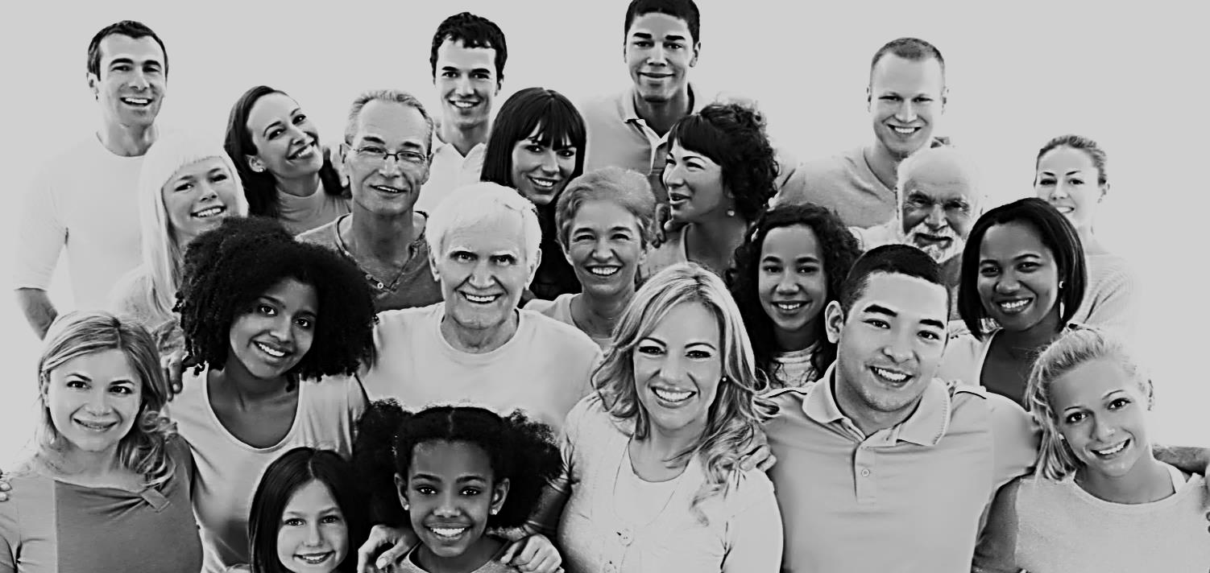
In what ways is diversity upside down?

Slide 10
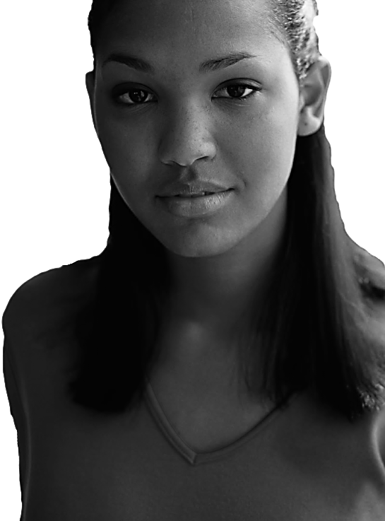
to be
YOUNG
millennials
is to be
technology
EXPERIENCED
culture

Slide 11
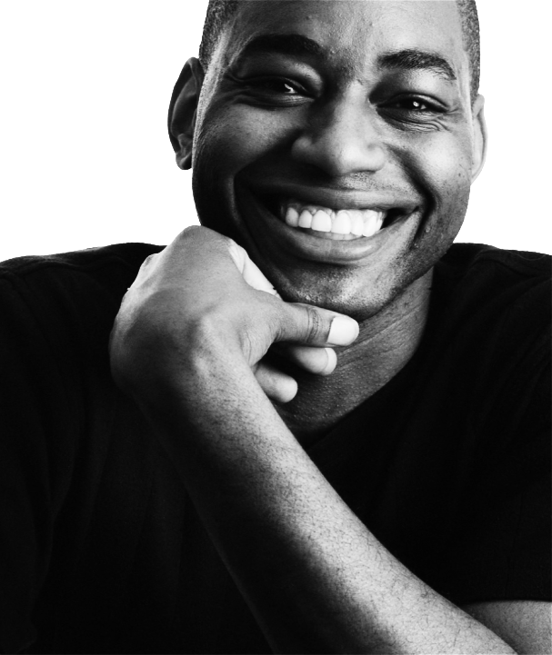
to be a
In 50 U.S. cities,
minorities are the majority
MINORITY
is to be a
In 10 U.S. states, white
men are a minority group
MAJORITY
This past summer, Latinos became largest ethnic group in California, surpassing whites

Slide 12
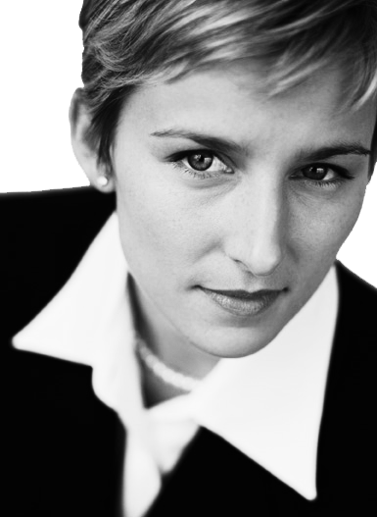
to be a
By 2015, two-thirds of undergrads will be women
WOMAN
is to be
More women than men are getting graduate degrees
RISING IN
OPPORTUNITIES
Of the 15 fastest growing jobs in the US, 13 are already female dominated

Slide 13
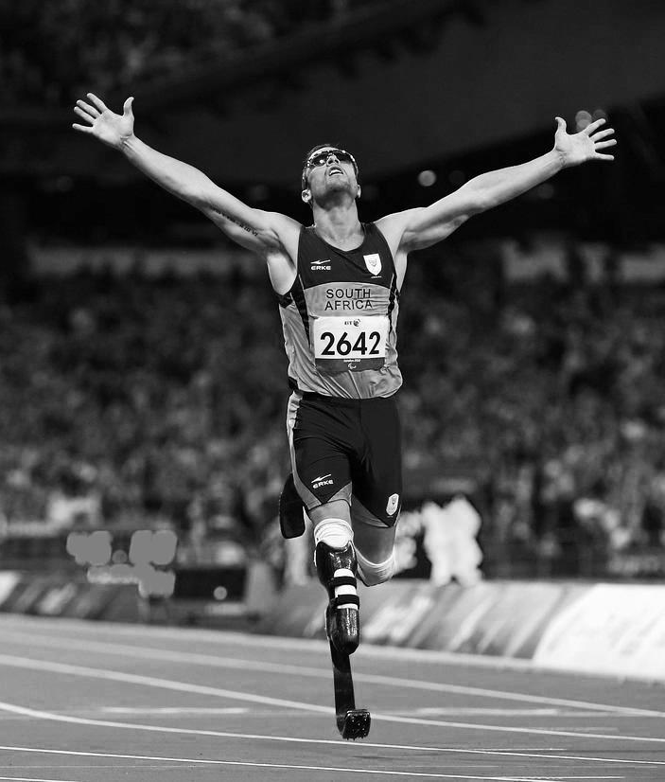
to be
Athletes with a disability not just in Paralympics
DISABLED
is to be
DIFFERENTLY
ABLED
Autism as a core competence
Most accurate proofreader, someone who is blind

Slide 14
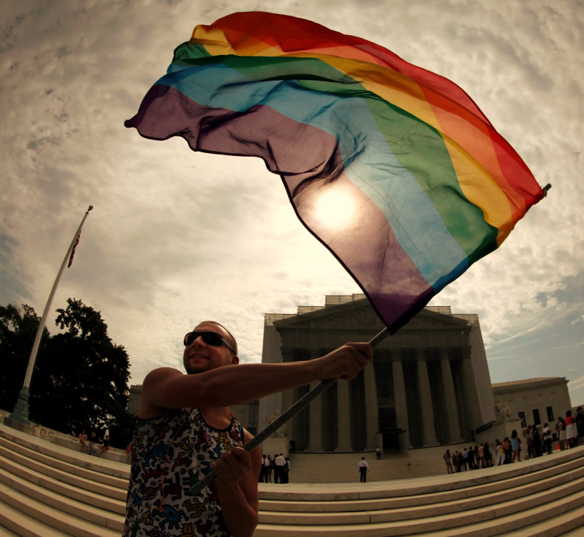
to be
Don’t Ask Don’t Tell gets repealed
OUT
Sitting U.S. president declares support of same sex marriage
is to be
Domino effect of various states passing same-sex marriage laws
IN
Prop 8 declared unconstitutional in 2013
DOMA declared unconstitutional in 2013

Slide 15
So how to thrive in upside-down,
next generation diversity?

Slide 16
Thriving in Upside-Down Diversity
1
Make a distinction between diversity and inclusion

Slide 17
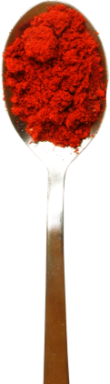
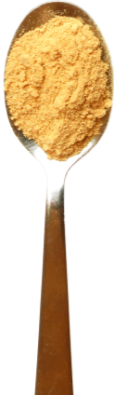
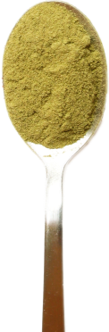
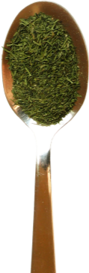
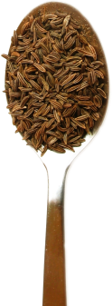
Diversity
is the Mix…
Inclusion is
Making the
Mix Work™

Slide 18
Thriving in Upside-down Diversity
2
Address diversity in a multidimensional way

Slide 19
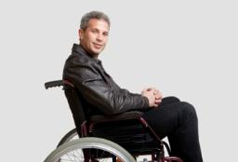
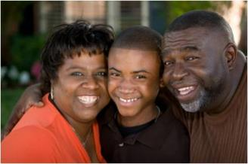
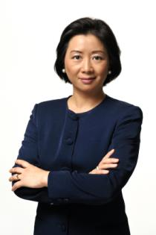
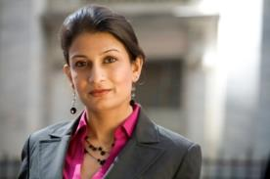
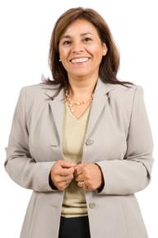
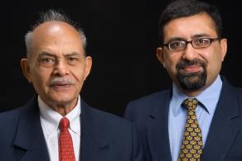
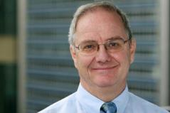
Who Are We As Individuals?
Female
Male
With Disability
Able-bodied
Transgender
Straight
Brazilian
Nigerian
Gen Y
Gen X
Boomer
Immigrant
Black
White
Latin
Roma
Hungarian
Chinese
Native-born
Introvert
Extrovert
Engineer
Artist
HR professional

Slide 20
Who Am I? Let Me Count the Ways…
Chinese
Man
Muslim
Baby Boomer
+
+
+
+
Woman
British
Woman
Man
+
+
+
+
Millennial
With Disability
American
White
+
+
+
+
Single Parent
Gay
Teaching in Malaysia
Elder Care Responsibilities

Slide 21

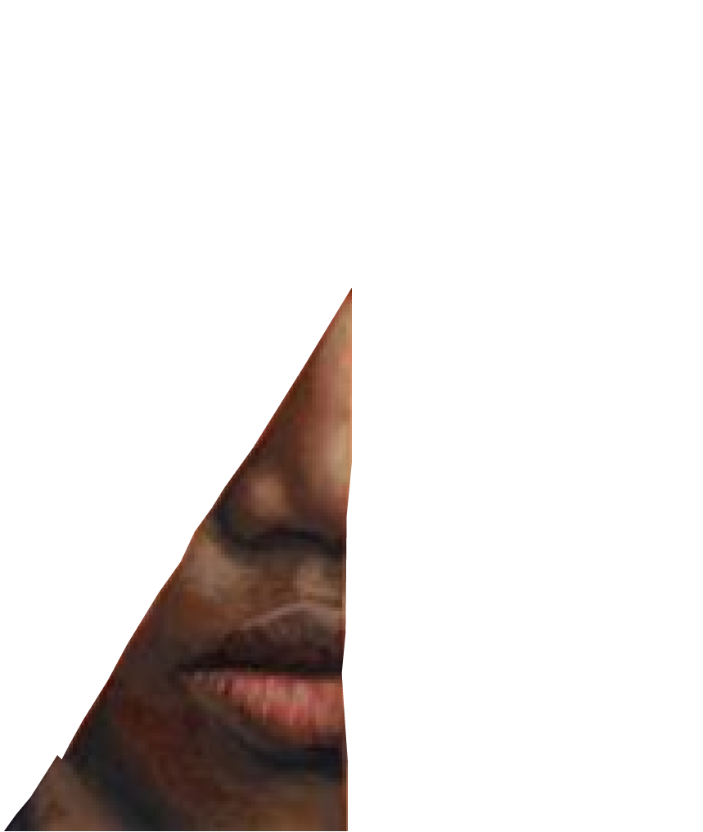
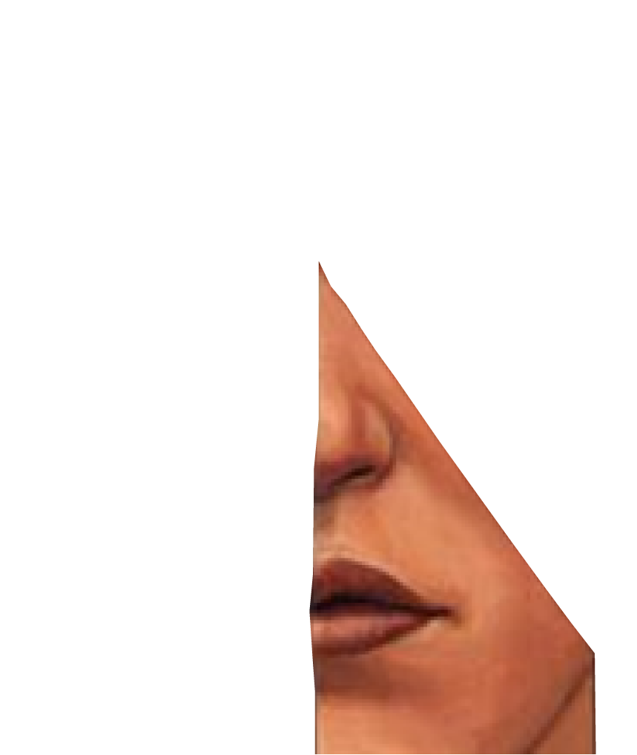
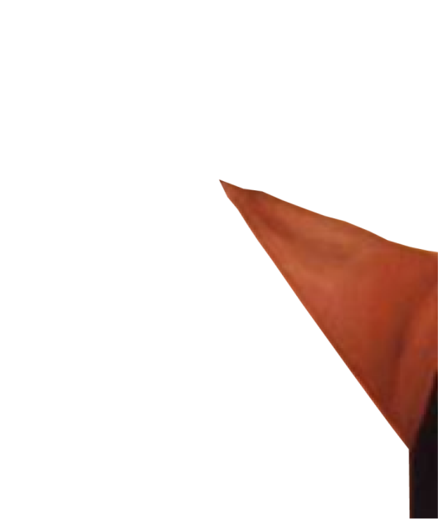
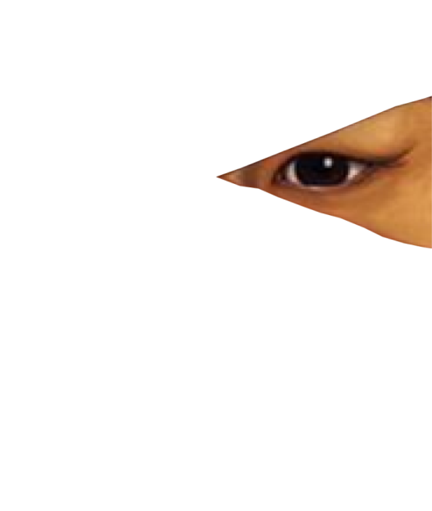




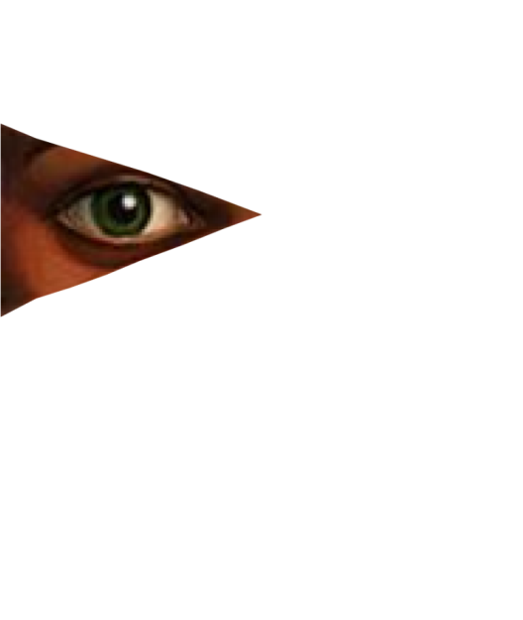
New Blends
GayVeteranXer
ExtrovertedPersonwithaDisability
MillennialFemaleManager
BoomerAfricanAmericanGeneral
ManagerwithAdultKids
LesbianSingleMother
ImmigrantWomanMuslimEngineer
WorkingSingleDadExecutive
WhiteMaleMinority

Slide 22
Thriving in Upside-Down Diversity
3
Inclusion is a skill, not an attitude

Slide 23
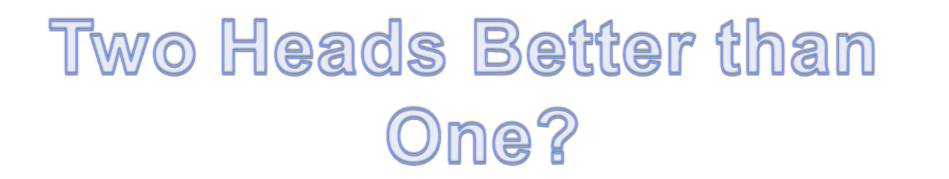
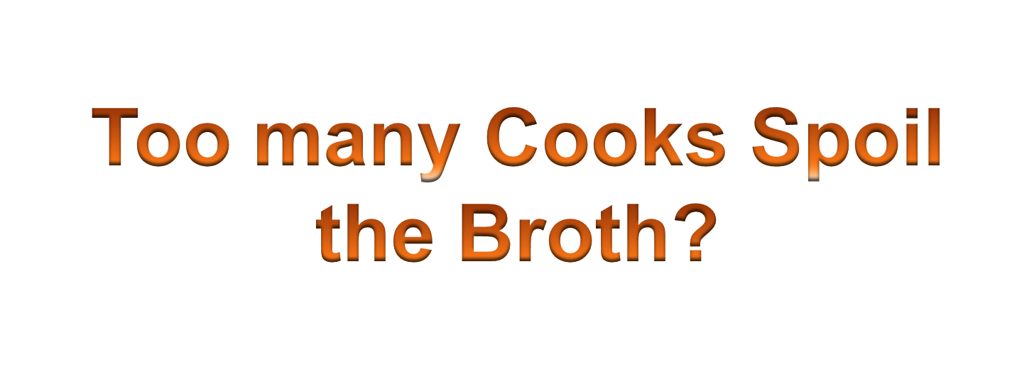

Slide 24

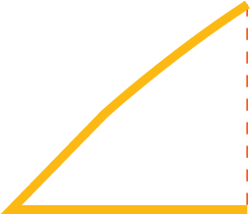
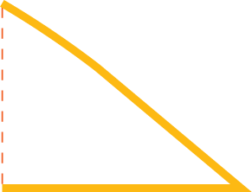








Impact of Diversity on Team Performance
Monocultural Teams
Multicultural
Teams
Multicultural
Teams
Average
Performance
+
+
+
+
+
+
+ +
less
Effectiveness in creative tasks
more
Reference: Adler, N. J. International Dimensions of Organizational Behavior. 4th ed. Cincinnati, OH: South-Western, 2002. | c. Milton J.Bennett, 2008

Slide 25
Pull yourself up by
your bootstraps
Tame the Wild West
God helps those who
help themselves

Slide 26
God willing
Dios quiere
What will be, will be
Que será, será
The plane left us!
¡El avión nos dejó!

Slide 27
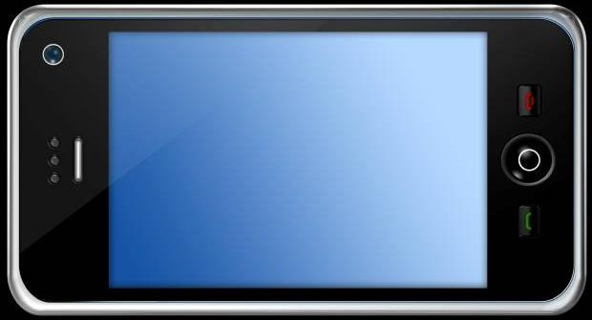

Diversity & Inclusion – Right Side Up
Notes:
27

Slide 28
Cảm ơn bạn
감사합니다
Grazie
Terima Kasih
Merci Beaucoup
谢谢
Shukran
Obrigado
¡Gracias!
Danke
Todah
Thank you!
Dankie
Спасибо
Selamat
Dhanyavaad
शुक्रिया
ขอบคุณ
ありがとう
তোমাকে ধন্যবাদ

