Slide 1
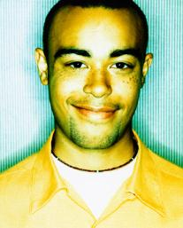
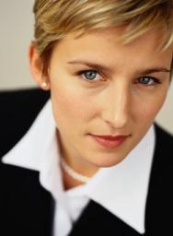
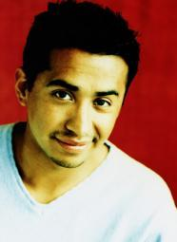

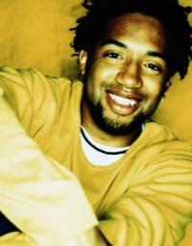
The Power of Inclusion
Collaborating Through Others

Slide 2


Agenda
Employee Engagement
The Manager’s Mindset
The Development Roadmap
How to meet the need
12
11
1
10
2
9
3
8
4
7
5
6
Agenda

Slide 3

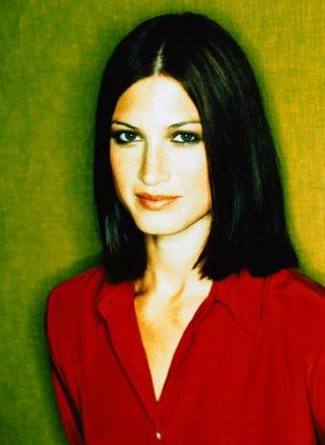

Diversity & Inclusion
DIVERSITY DEFINED
The presence of differences that make each person unique, that can be used to differentiate groups and people from one another.
INCLUSION DEFINED
The full engagement and development of
all associates
DEVELOPMENT
IS THE ANSWER
Diversity
& Inclusion

Slide 4
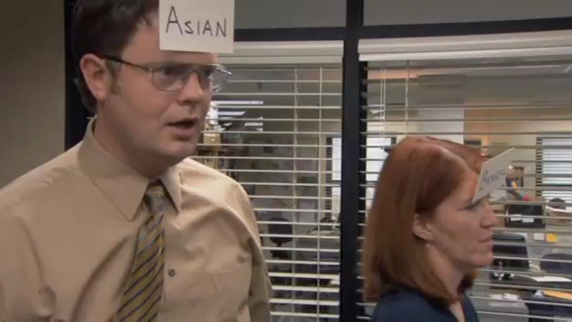
Video
All Rights Reserved. NBC Universal, Inc.

Slide 5

Employee Engagement
The emotional connection employees have with the company that influences the extent to which they are willing to demonstrate consistently high levels of commitment and contribution

Slide 6
Research on Employee Engagement
Perform 20% better and are 87% less likely to leave.
Corporate Leadership Council, 2004
Fully
engaged
employees
Feel more secure at work, are more productive, profitable, safer, and they create stronger relationships.
Gallup Management Journal, 2006
Handle workplace stress differently—they report feeling better equipped to take on new challenges and opportunities.
Gallup Management Journal, 2006

Slide 7
Research on Employee Engagement
In a survey of
360,000
employees:
Those companies that had a
high number of self-identified “disengaged employees” lost 2.01% operating margin and were down 1.38% in net profit during a three-year period.
During that same period, those companies that reported having a highly-engaged work force boasted a 3.74% operating margin and 2.06% net profit margin increase.

Slide 8

Four Generations in the Workforce-One Key Aspect of Diversity
MATURES (1945 and Before)
BOOMERS (1946 - 1964)
GENERATION X (1965 – 1980)
GENERATION Y (1981 – 1999)
10%
46%
29%
15%

Slide 9



Fixed Capacity
Capacity building
What is a Mindset?
When it comes to learning capacity,
Fixed Capacity mindset operates from “some have it and some don’t.”
FAILURE OR DIFFICULTY INDICATES THE LIMITS OF A
PERSON’S ABILITY AND LEARNING CAPACITY.
A MINDSET is a way of thinking about people
and their potentials.
IT DIRECTS ACTION
The Capacity Building mindset operates from “most people have
enough mental capacity for continuous learning and development.”
FAILURE OR DIFFICULTY IS FEEDBACK INDICATING WHAT
THE INDIVIDUAL MUST IMPROVE UPON.

Slide 10

Video
All Rights Reserved. NBC Universal, Inc.

Slide 11

The
ROADMAP
11
DEVELOPMENT

Slide 12
The Original Research
Salary &
Expectation
Mean Performance Contribution
70
65
60
55
50
45
Value of
Contribution
40
Job Assignments:
1. Visible
2. Important
3. Complex
35
30
25
20
21 to 25
26 to 30
31 to 35
36 to 40
41 to 45
46 to 50
51 to 55
By Age Group

Slide 13
Four Stages® of Contribution
Stage 4.
Contribute Strategically
Stage 3.
Contribute through Others
Stage 2.
Contribute Independently
Stage 1.
Contribute Dependently
Impact
Key Transitions (Novations)

Slide 14
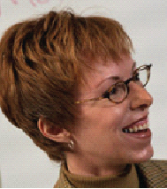
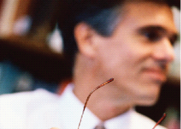

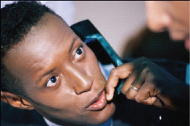


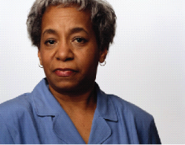

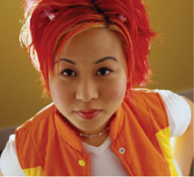

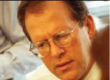
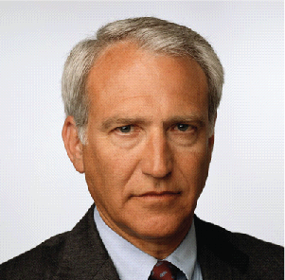



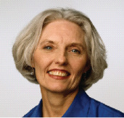
How to Meet the Needs of a Multi-Cultural Workforce
How can organizations begin to meet the diverse needs of multiple generations?

Slide 15

Key Drivers of Engagement
Four key drivers of engagement for each generation:
    Communication
    Development
    Coaching/Mentoring
    Feedback

Slide 16

Communication
  Shape messages so they will listen
  Vary your communication style/approach

Slide 17

Development
Position assignments to build skills
Be intentional about motivating
Development

Slide 18
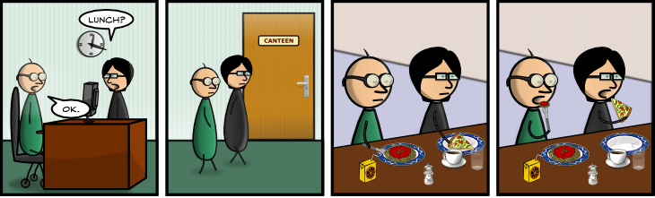
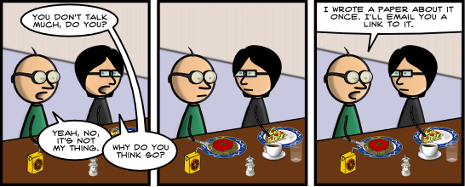
Coaching
Reinforce learning for technical,
relational and influencing skills

Slide 19
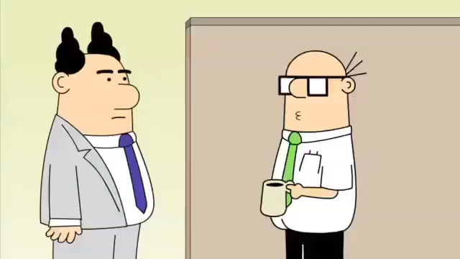
Feedback
Be clear about expectations
Provide candid assessments about progress or improvement needs

Slide 20

Inclusion is Measured by Employee Engagement

Slide 21
The Power of Inclusion
Collaborating Through Others

